Slide 1

Eliseo Martelli @
Università degli Studi di Torino
CREDO
Customizable, Reproducible, Dockerfile Generator for Bioinformatics Applications.

Slide 2
Quick look
Are dependencies
really important?

Slide 3
: an example
Quick look
Are dependencies
really important?

Slide 4
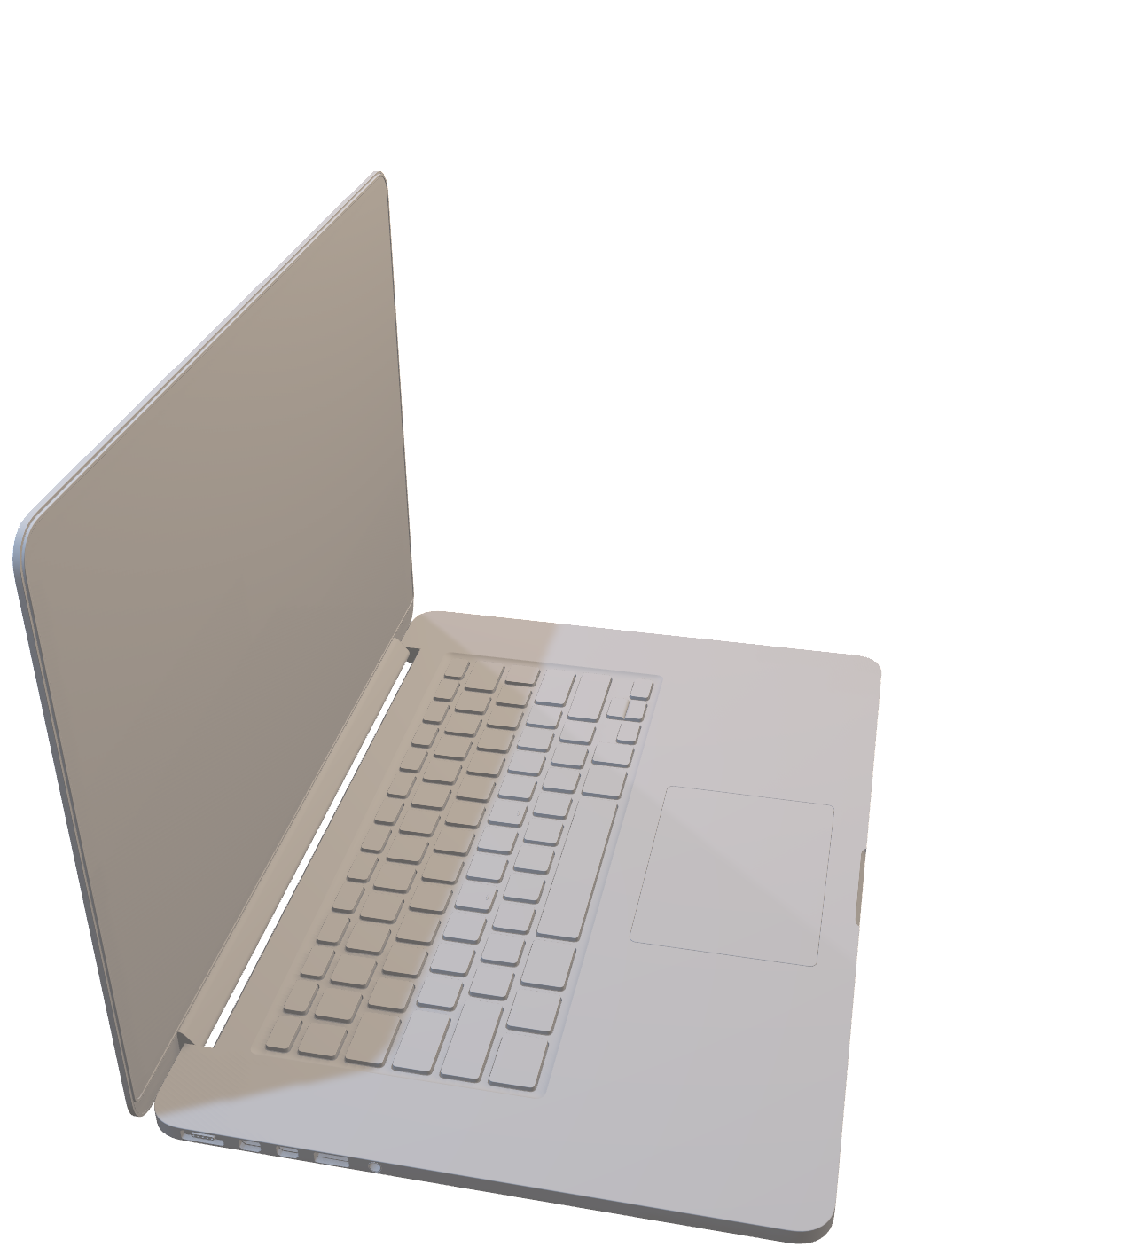
Quick look
: an example
Genome-wide translocation sequencing reveals mechanisms of chromosome breaks and rearrangements in B cells.
10.1016/j.cell.2011.07.049

Slide 5
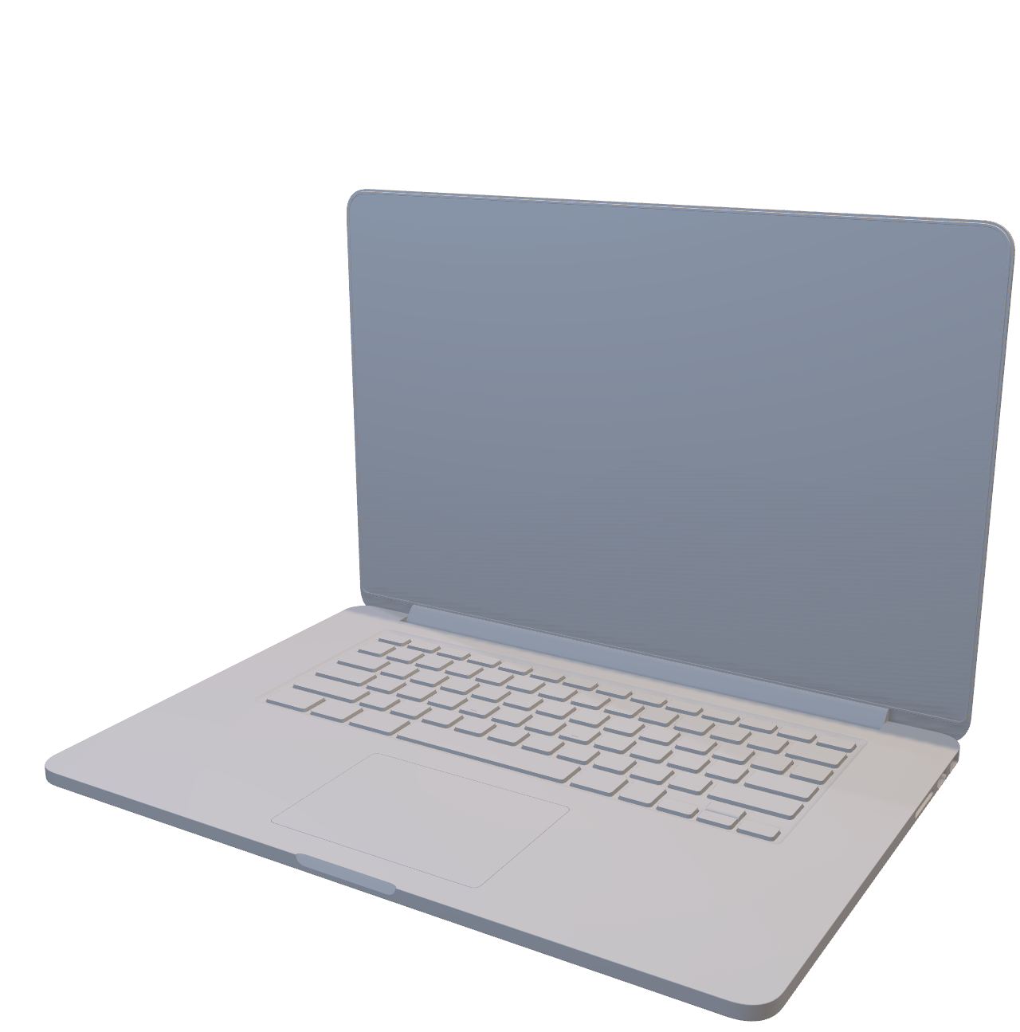
Quick look
: an example
Genome-wide translocation sequencing reveals mechanisms of chromosome breaks and rearrangements in B cells.
10.1016/j.cell.2011.07.049
Properly working only on a 2011
MacBook Pro in Boston.

Slide 6
Quick look
: an example
BLAST
is a core dependency of this project.
Genome-wide translocation sequencing reveals mechanisms of chromosome breaks and rearrangements in B cells.
10.1016/j.cell.2011.07.049

Slide 7
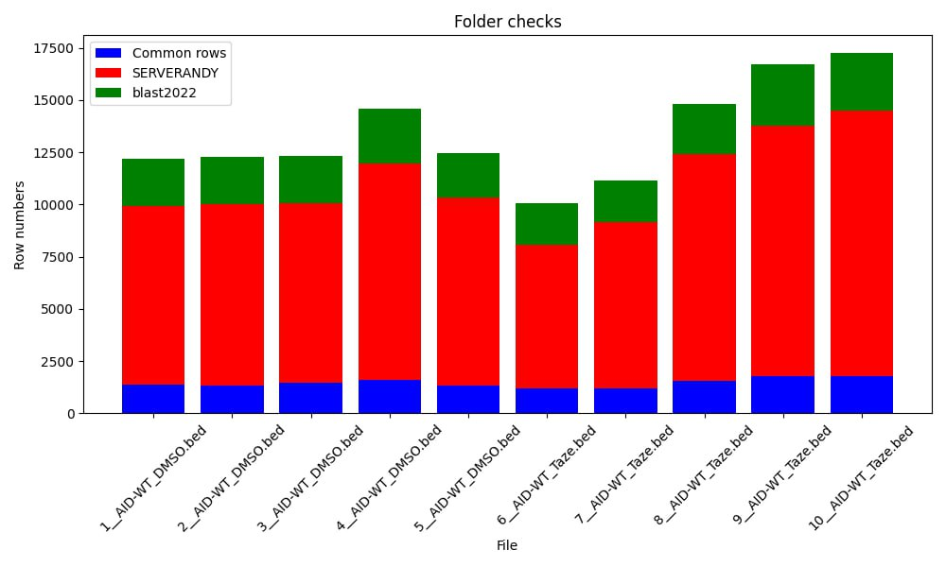
Quick look
: an example
blast 2.12.0, build Mar 8 2022
blast 2.2.31, build Jun 2 2015
Genome-wide translocation sequencing reveals mechanisms of chromosome breaks and rearrangements in B cells.
10.1016/j.cell.2011.07.049

Slide 8
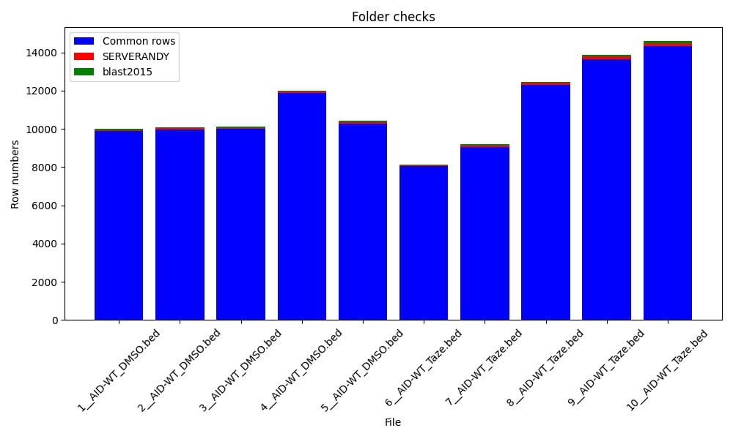
Quick look
: an example
blast 2.12.0, build Mar 8 2022
blast 2.2.31, build Jun 2 2015
Genome-wide translocation sequencing reveals mechanisms of chromosome breaks and rearrangements in B cells.
10.1016/j.cell.2011.07.049

Slide 9
Is it FAIR?

Slide 10
Problems
01
02
03
Segmented toolkit and ecosystem
make difficult to achieve fully reproducible environments.
Absence of standardization
intensifies the difficulty
of a cross-scenario solution.
Containerization falls short
in providing a dependency management framework.

Slide 11
Problems
01
02
03
Segmented toolkit and ecosystem
make difficult to achieve fully reproducible environments.
Absence of standardization
intensifies the difficulty
of a cross-scenario solution.
Containerization falls short
in providing a dependency management framework.

Slide 12
Problems
01
02
03
Segmented toolkit and ecosystem
make difficult to achieve fully reproducible environments.
Absence of standardization
intensifies the difficulty
of a cross-scenario solution.
Containerization falls short
in providing a dependency management framework.

Slide 13
Problems
02
03
Absence of standardization
intensifies the difficulty
of a cross-scenario solution.
Containerization falls short
in providing a dependency management framework.

Slide 14
Goals
F

Slide 15
F
Goals
Flexibility
01
A

Slide 16
F
A
Goals
Adaptability
01
02
S

Slide 17
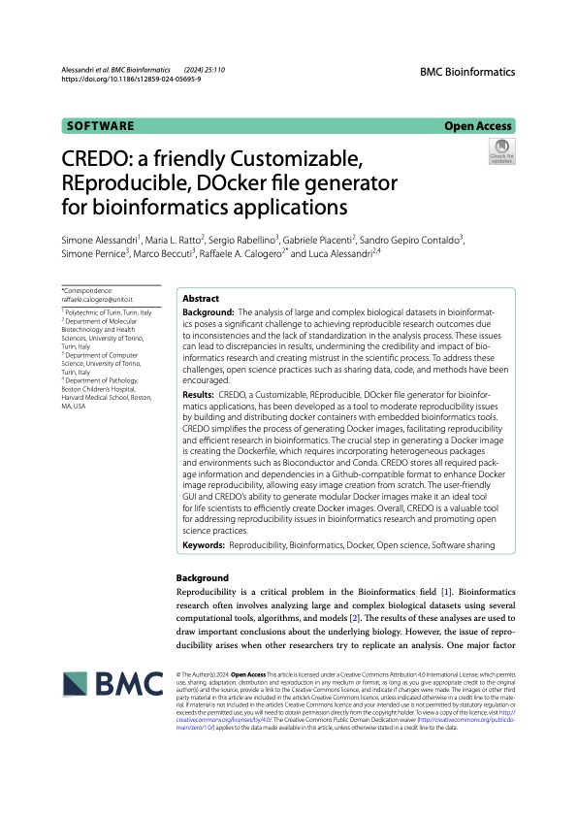
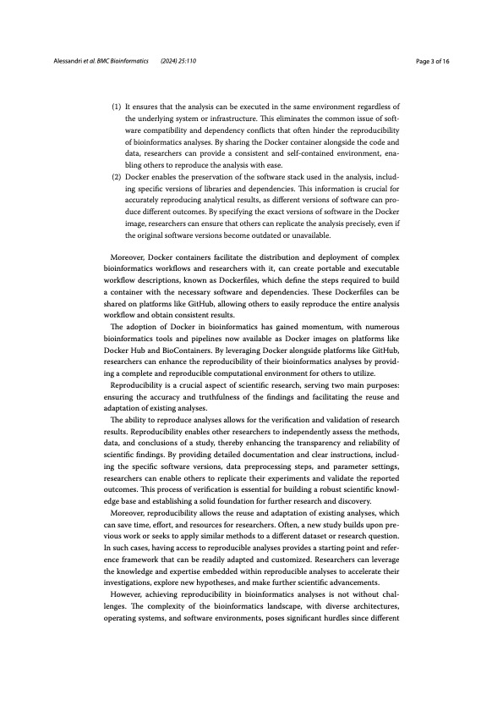
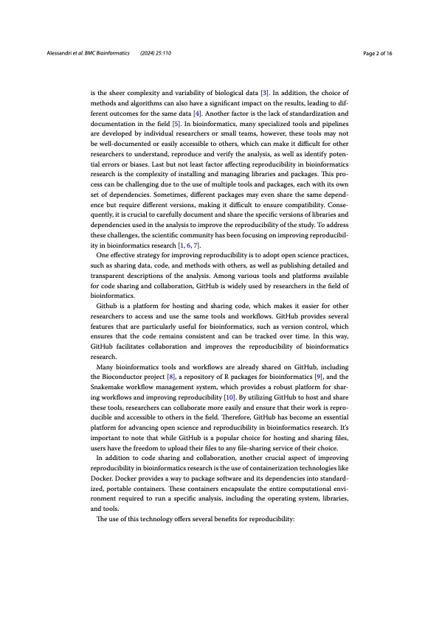
A
S
Credo
Goals
Scalability
02
03

Slide 18
Credo
01
Records all the information and dependencies required to build an environment.
10.1186/s12859-024-05695-9

Slide 19
Credo
01
Records all the information and dependencies required to build an environment.
02
Resolves the dependency tree across various package managers.
With some “intelligence”.

Slide 20
Credo
02
Resolves the dependency tree across various package managers.
With some “intelligence”.
03
Tests every change before applying it to the environment to ensure feasibility.

Slide 21
Credo
+
Intelligence
03
Tests every change before applying it to the environment to ensure feasibility.

Slide 22
Credo
+
Intelligence
Not every installable package
is a good citizen.
Sometimes dependencies are implicit.
How can we provide a unified user experience?

Slide 23
Credo
+
Intelligence
Not every installable package
is a good citizen.
Sometimes dependencies are implicit.
How can we provide a unified user experience?

Slide 24
Credo
+
Intelligence
Not every installable package
is a good citizen.
Sometimes dependencies are implicit.
How can we provide a unified user experience?

Slide 25
Credo
+
Intelligence
Static Analysis
How can we provide a unified user experience?
1
2
Deep inspection of packages before the installation.

Slide 26
Credo
+
Intelligence
Dynamic Analysis
How can we provide a unified user experience?
2
3
Install log inspection during the testing phase.

Slide 27
Credo
+
Intelligence
Global Knowledge
How can we provide a unified user experience?
3
Previous knowledge about a package is maintained globally.

Slide 28
Results

Slide 29

Results
Single entry point
Docker-embeddable
Batteries-included
Multiplatform
environment.CREDO
Cryptographically verified

Slide 30
Now & Future

Slide 31
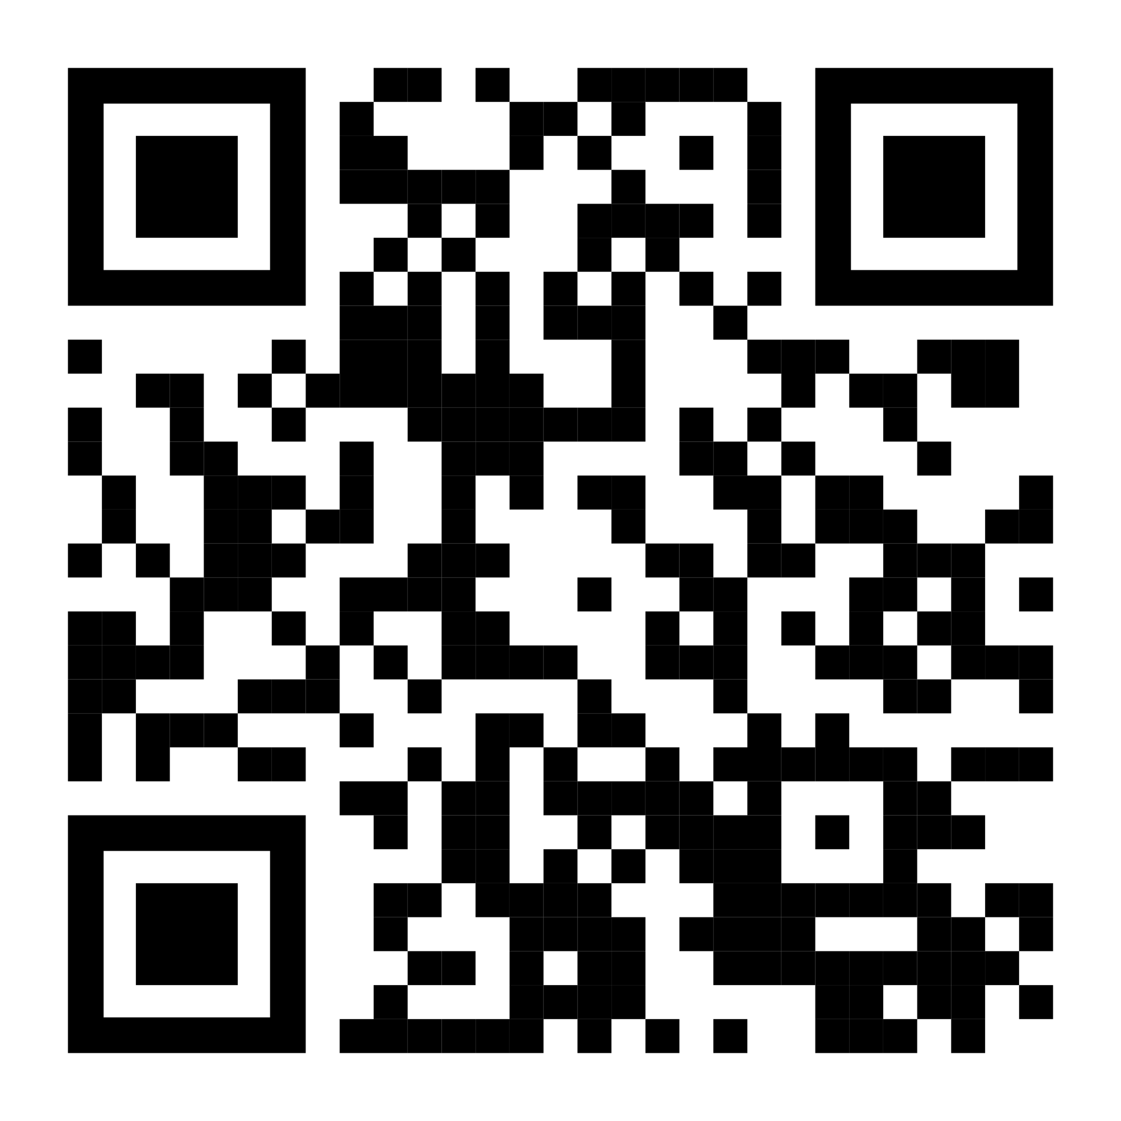
Now & Future
Open Source
We are building in the open, sharing our processes.
IT WORKS!
We have a first working copy of CREDO working across platforms.

Slide 32
Now & Future
IT WORKS!
We have a first working copy of CREDO working across platforms.
Community
A strong community is necessary to build a comprehensive ecosystem.

Slide 33
Now & Future
Community
A strong community is necessary to build a comprehensive ecosystem.

Slide 34
Thank you

